Slide 1
IoT-Based Fire and Gas Leak Detection System
Assessor:
Eng. NTM. Sajith
Presenters:
MN. Sihanas
AJ. Nishak Mohammed

Slide 2
Introduction
This project focuses on safety by developing an IoT-based gas and flame detection system. It uses sensors with real-time alerts via buzzer, LEDs, and the Blynk app to ensure early hazard detection and quick response.

Slide 3
Problem Statement
Unnoticed Threats: Gas leaks and fire incidents frequently remain undetected during their initial phases, posing serious risks to human life and property.
Slow Emergency Action: The absence of real-time notifications delays timely response and intervention during emergencies.
Conventional System Limitations: Traditional alarm systems lack IoT integration, preventing remote monitoring and control.
Safety Risks: Inadequate detection mechanisms reduce the overall safety of households and workplaces.

Slide 4
Objectives
1. Detect Hazards Automatically: Use MQ2 and flame sensors to identify gas leaks and fire in real time.
2. Provide Local Alerts: Trigger buzzer and LEDs instantly to warn nearby users.
3. Enable Remote Monitoring: Send notifications to the Blynk app for quick action even when away.
4. Enhance Safety: Reduce risks by ensuring timely detection and response.

Slide 5
Proposed Solution
Proposed Solution Overview:
IoT-enabled system for detecting gas leaks and flames using ESP32, MQ2, and IR flame sensor with real-time alerts.
Key Features:
Local alerts via buzzer and LEDs.
Remote notifications through the Blynk app.
Continuous monitoring for early hazard detection.
Advantages:
Ensures timely response to emergencies.
Improves safety in homes and workplaces.
Scalable and cost-effective IoT-based safety solution.

Slide 6


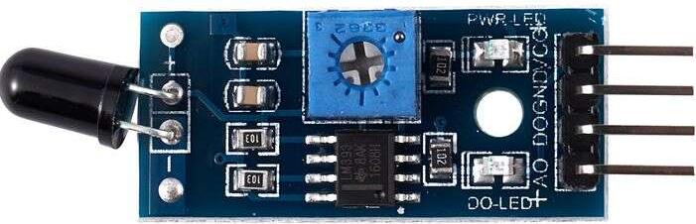

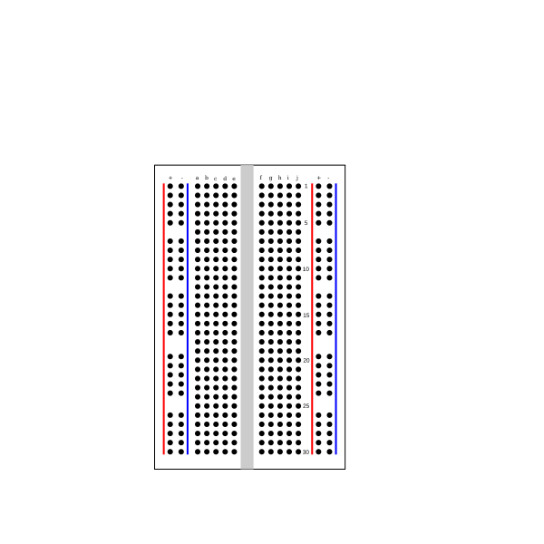

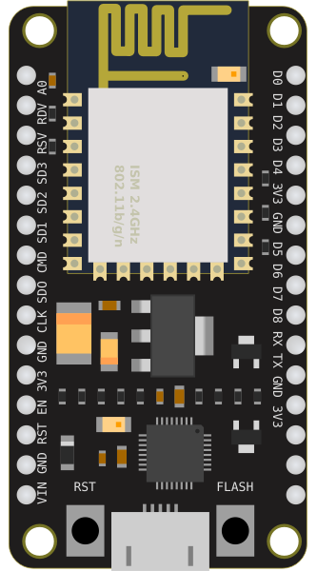


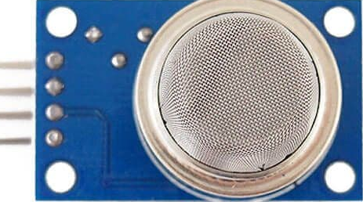

System Architecture
wire
wall
IR
ESP 32
MQ2
Buzzer
BLYNK App

Slide 7
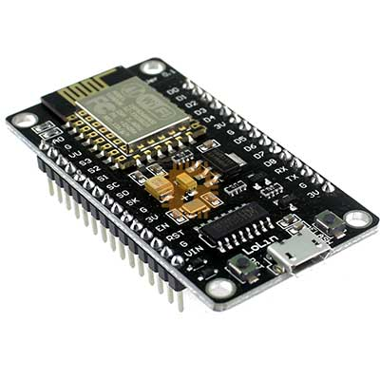

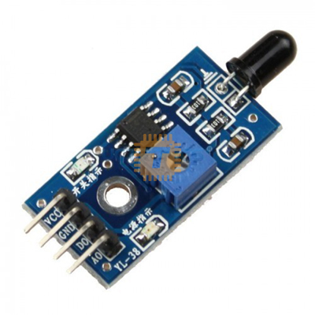


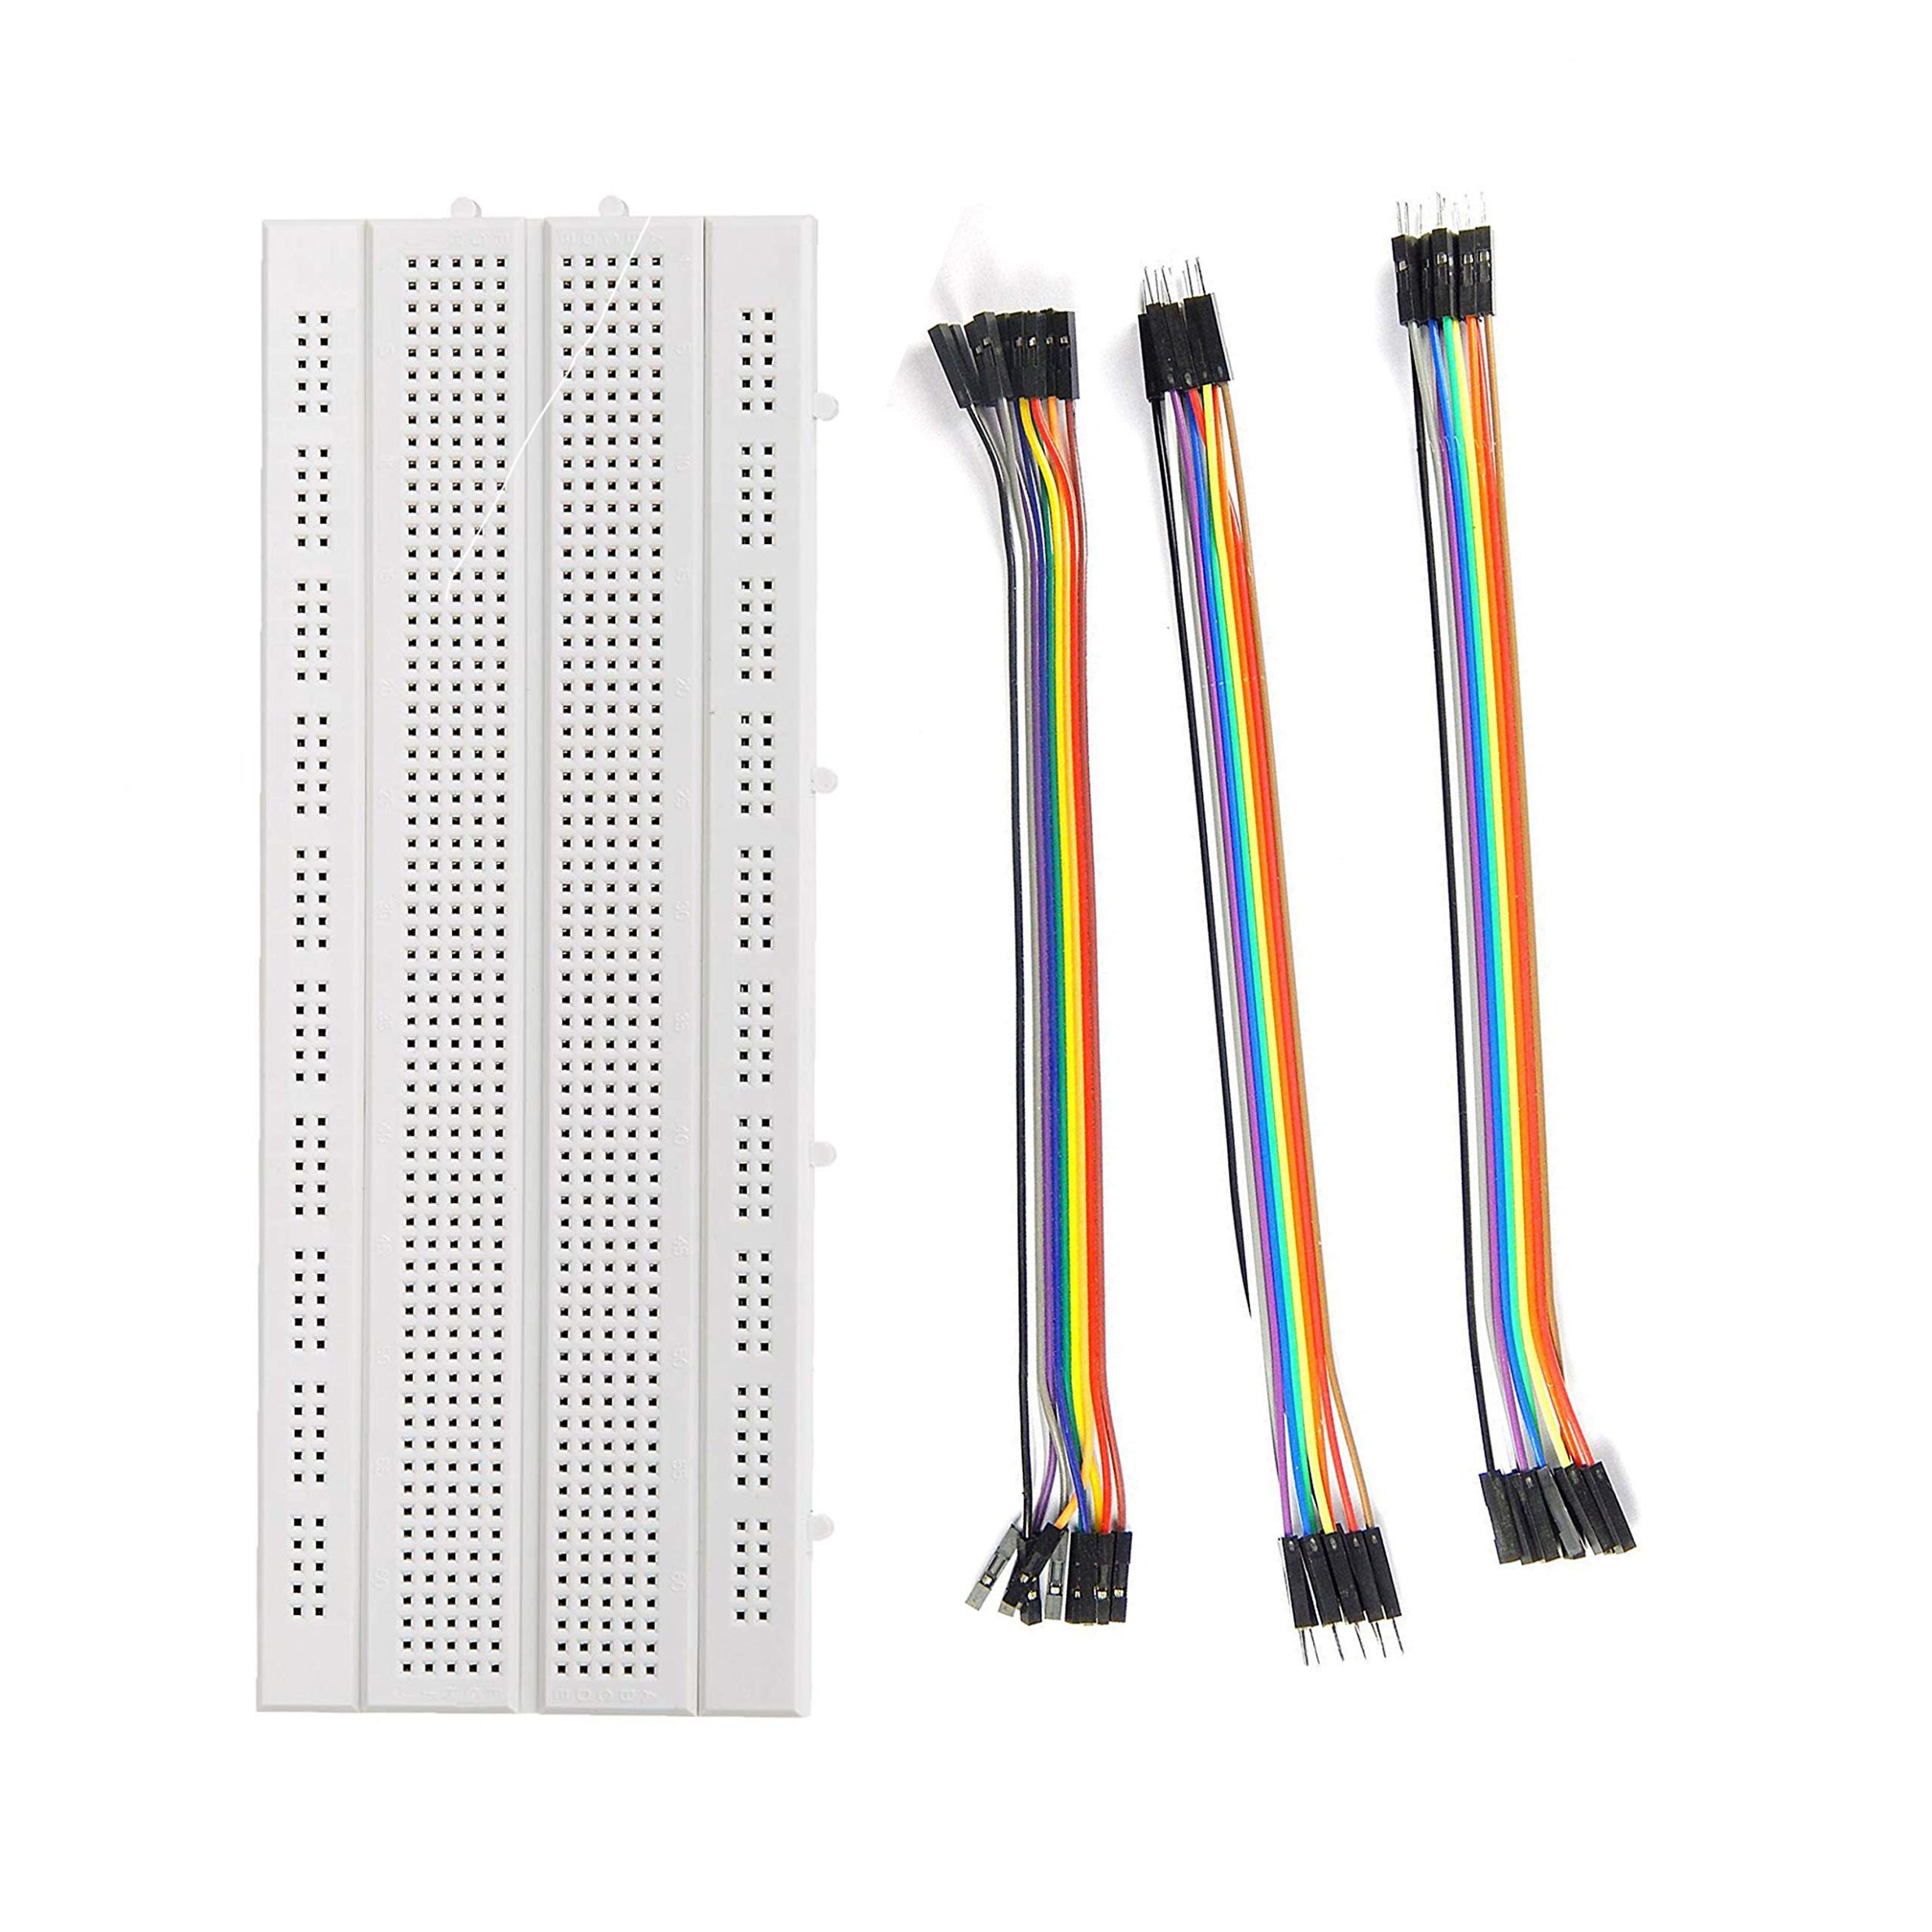
Hardware Requirements
MQ2 Gas Sensor
NodeMCU (ESP32) – Dev Board
MQ2 - Gas Detection Modul
Flame Sensor - IR module
Buzzer
LCD Display with I2C module
Breadboard & Jumper Wires

Slide 8


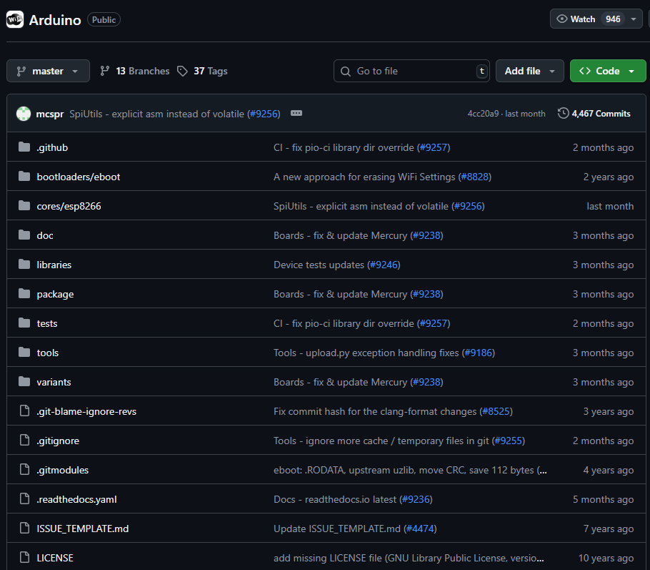

Software Requirements
MQ2 Gas Sensor
Arduino IDE – Code development and uploading
Blynk Application (Mobile) – IoT dashboard and control
Blynk Library – Integration with Arduino code
ESP32 Board Package – For NodeMCU in Arduino IDE

Slide 9
Conclusion
This proposed IoT-based gas and flame detection system aims to address critical safety challenges by enabling early hazard detection and rapid response. Through the integration of sensors with real-time alerts delivered via buzzers, LEDs, and the Blynk application, the system is expected to enhance safety in both residential and workplace environments. By leveraging IoT technology, the project seeks to provide a reliable, efficient, and scalable solution that reduces risks to life and property while contributing to the advancement of modern safety practices.

